Slide 1
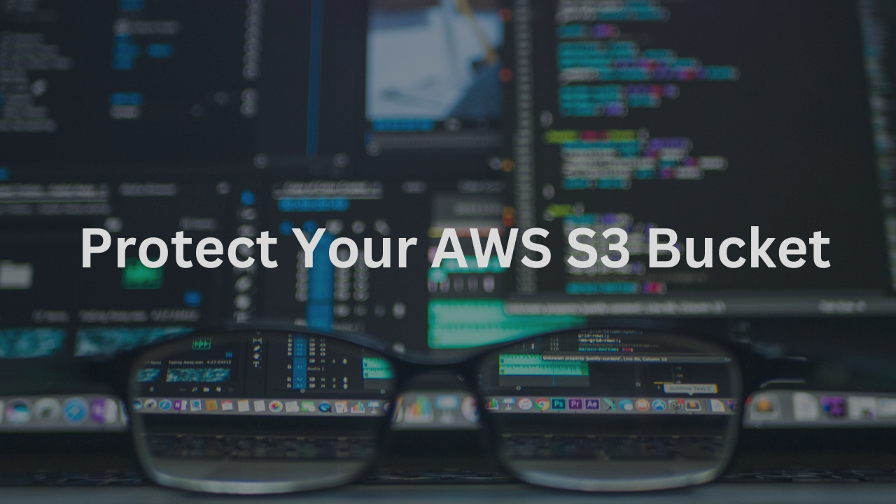
Notes:
It's [Name] from information security, I wanted to take 60 seconds of your time to make you aware of a serious risk that could potentially impact our organization and your data.

Slide 2
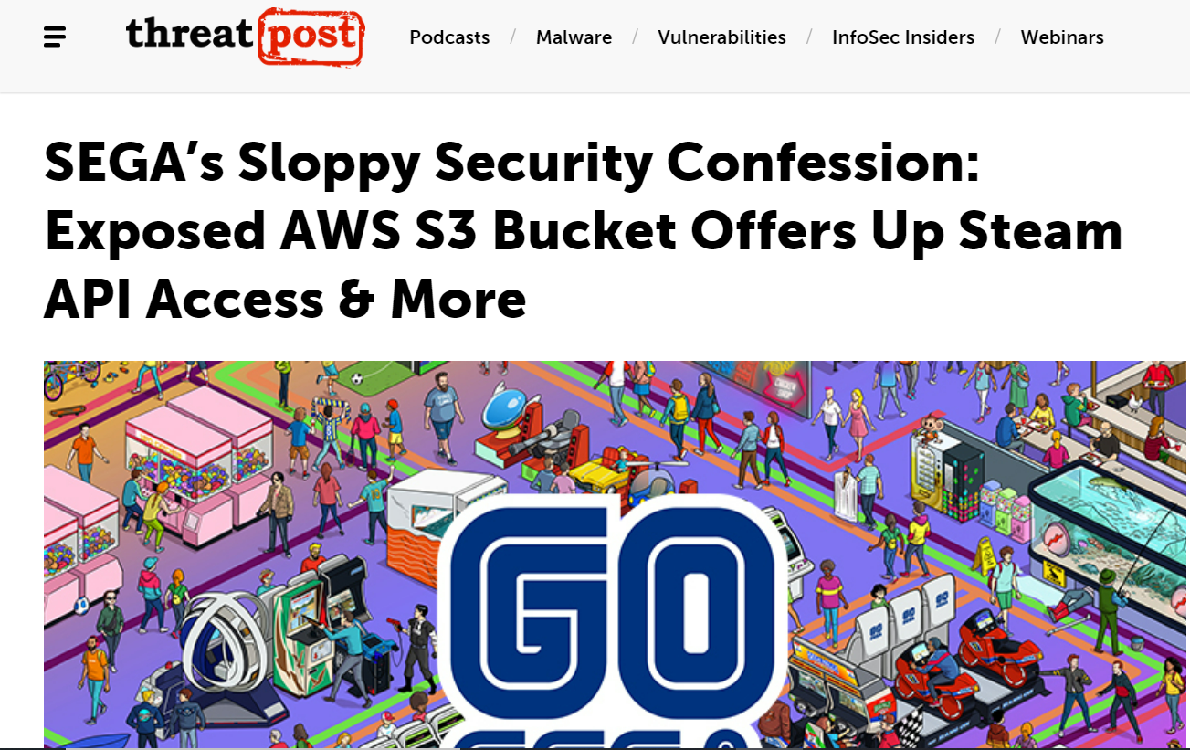
Notes:
Just recently, Sega, the video game company, had a major data breach because of misconfigured AWS, s3 buckets, and API keys that accessed internal documentation IP. It was really a bad situation.

Slide 3
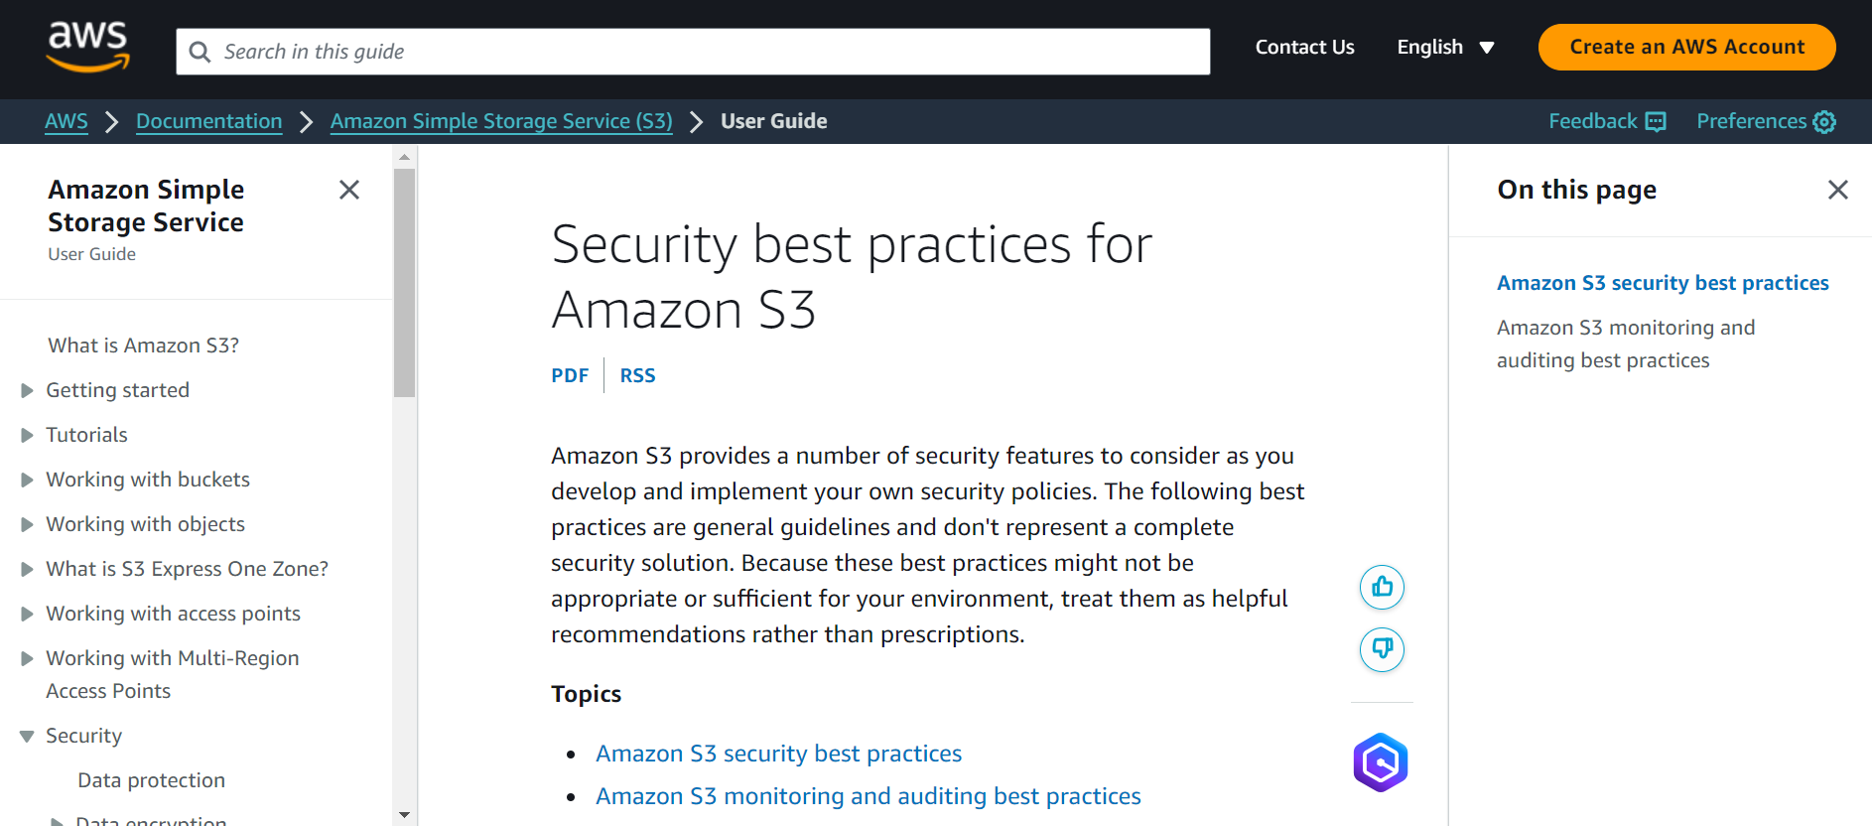
Notes:
If you are using AWS s3 buckets, whether for like beta testing, development or full on supporting a production system, you need to be aware that AWS has made available all sorts of great documentation on how to both properly secure and verify that you've secured those s3 buckets and how to validate and verify who and where has been accessing those s3 buckets. So you can have assurance that is only being accessed by those that should. We definitely don't want a data breach on our hands and I know you want your data protected. Thanks so much.
Recording: https://www.loom.com/share/befdfc11b0a94512be39726484bbc215?sid=76b55e3c-cb0f-40bc-b5e9-fce59b8e230a

